Slide 1
Diagram of Kubernetes & Things need to consider to run ES
Written by Ted.Jung

Slide 2
Types of Kubernetes & Relationship between types
Service
Pod
Ingress
Controller
Ingress
rule set
Endpoints
Ingress
Controller
Kubernetes API
monitoring
Ingress
(rule set)
Endpoints
NetworkPolicy
rules
Developers
switching between clusters by context
Limits
Region-asia1
(Resource, cpu/mem)
no clusterip
no load balancing
no proxy
Cluster
Namespace
Pod
Cluster
Namespace
Service
Pod
Headless service
Container
StatefulSet
Federation
ClusterIP (internal)
--------------------------
Nodeport
Loadbalancer
ExternalName
Port proxy
Container
Cluster
(=context))
CPU
Cluster
(=context))
1:N
1:N
1:N
CPU
Region-asia2
1:N
GPU
(applications on )
GPU
stateful
Mem
Mem
Ordinal index
Stable NetworkID
Stable Storage
Cluster
TLS(Certificate signing Request)
ConfigMap
Horizontal pod Autoscaler
(cpu,mem,custom)
stateless
sync controller by
federation controller manager
demonset
secret
configmap
Deployment
Persistent
VolumeClaim
(storageClassName)
(Size,Mode)
Rollout & Rollback
Update image
Replicaset
Scaling a deployment
Pause & Resuming
* pod updating
ReplicaSets
Certificate
Signing
Requests
stateless
StorageClass
kubeadm join with token
-provisioner
Ceph/Gluster/AWS/
Ccloud/NFS/iSCSI
-parameter
(size, access mode)
(No NS)
Replication
Controller
Persistent
Volume
(No NS)
kubernetes
package
CoreDNS
Secret
Service
Account
Service
Account
Operator
ThirdPartyResources
Node
(Node selector)
Helm
DNS entry
RBAC
Token
(kubeadm –ttl=0)
ClusterRole
ClusterRole
Binding
Role
Binding
Role
DaemonSet
KubeDNS
rules
rules
service-name.namespace-name.svc.cluster.local
namespace or all namespaces
the same namespace
Job

Slide 3
Ingress controller in Kubernetes
Purpose: exposing *services to the world
example
Ingress controller
deployment
Nginx controller
service
Three ways to customize controller
ConfigMap (global environment)
Annotations
Custom template
replica set
replication controller
Notes:
In Kubernetes, a controller is a control loop that watches the shared state of the cluster through the apiserver and makes changes attempting to move the current state towards the desired state

Slide 4
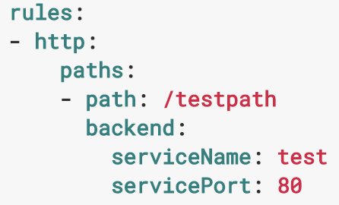
Ingress Controller (how it works..)
How it works..:
load balance traffic, terminate SSL, name based virtual hosting
Edge router (H/W, S/W)
Ingress Controller
-> daemon,
-> handle ingress resources
-> pod (in terms of k8s)
Cluster
Ingress
Controller
annotation: nginx
Ingress
Controller
annotation: haproxy
Ingress
Controller
Ingress
Controller
annotation: gce
Ingress (a collection of rules)
Node
Node
Node
service
service
service
allow inbound connections
to reach the cluster services
pod
pod
pod
<- incoming requests
(currently, http only)
Service

Slide 5
Helm
1. wget helm client :
wget https://storage.googleapis.com/kubernetes-helm/helm-v2.7.0-linux-amd64.tar.gz
2. unpack:
tar -zxvf helm-v2.0.0-linux-amd64.tgz
3. move helm binary to location:
mv linux-amd64/helm /usr/local/bin/helm
Client
1. init Tiller:
helm init
how to verify whether the helm be installed well?
kubectl get pods – kube-system
2. helm version
Server
Helm
(client)
Tiller
(server)

Slide 6
Horizontal Auto Scaling(pods) by controller in Kubernetes
control loop
TargetNumOfPods = ceil(sum(CurrentPodsCPUUtilization) / Target)
10% tolerance (Scale out, Scale in)
kube-controller-manager
(daemon process)
30 secs
Namespace: kube-system
Heapster
e.g)
-object: horizontal auto scaler
-via: kube-apiserver
-what: regulate the state of system,
(target utilization mean value=??)
scale sub-resource
...
replication controller
Pod
scaling
Pod
deployment
1> queries:
resource(targeted pod) utilization against the metrics
(specified in each HorizontalPodAutoscaler definition)
2> condition:
value > specified definition
3> execute:
scale the number of desired replicas by ratio
replica set
kubectl autoscale deployment foo --min=2 --max=10
kubectl autoscale rc foo --max=5 --cpu-percent=80
Notes:
In Kubernetes, a controller is a control loop that watches the shared state of the cluster through the apiserver and makes changes attempting to move the current state towards the desired state

Slide 7
StatefulSet
Statefulset is a combination of
Service
VolumeClaim
Stable, unique network identifiers
Stable, persistent storage
Ordered, graceful deployment and scaling
Ordered, graceful deletion and termination
Ordered, automated rolling updates
Statefulset
Storage
VolumeClaim
StorageClass
Block
Storage
NFS
VolumeClaim
(Name web)
Service
(name www, Replicas=3)
Pod
(web-0)
Volume
(www-web-0)
Service
Pod
(web-0)
Volume
(www-web-0)
Ordinal No
(0..#)
Pod
(web-0)
Volume
(www-web-0)
(ex: www-web-#n)

Slide 8
Persistent Volume
ElasticSearch
Cassandra
PostgreSQL
redis
mongoDB
MySQL
riak
etcd
just file
raw data
Structured / Semi-structured Data
Relational and transactional data
Searchable
Unstructured Data
Image, Video, Audio, Documents
Long term storage

Slide 9
DNS
KubeDNS Scaling
Internal Naming Service
in Kubernetes
(SkyDNS)
External Naming
Service
(CoreDNS, etc)
Ingress
Controller
NodePort
Internal(Good)
External(need to be developed)

Slide 10
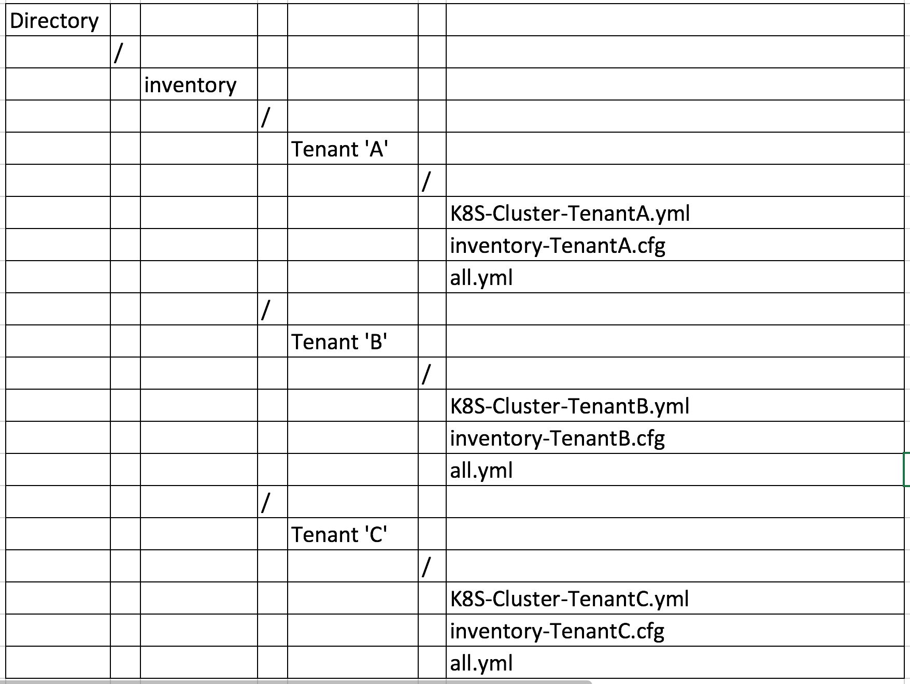
Network
Rule
Easy to operation (BGP, best solution among CNI plugins currently)
BGP peering to Route Reflector
Allocate unique IP ranges to each Tenant separately
* Inject this value into the each line of Kubespray (inventory.cfg, k8s-cluster.yaml)
Target files,be used by kubespray, will be updated regarding every attributes of network
Tenant(Services) | Pod IP Ranges
Tenant ’A’ | 10.233.0.0/18
Tenant ‘B’ | 10.233.64.0/18
Tenant ‘C’ | 10.233.128.0/18
Service ‘A’
Service ‘B’
Service ‘C’

Slide 11
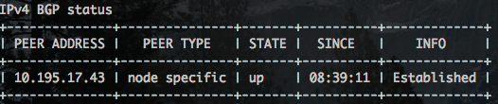
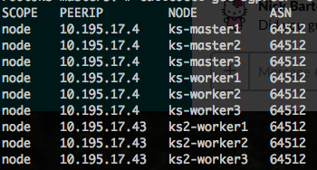
Network
Peering
Not full-mesh by nodes
* Every master & worker nodes peer with route reflectors
More performant & simpler than full-mesh architecture
Pl, check ”up and run” status of calico like below.
One row will come out because of only peer to RR1
Each group peers with route reflectors
RR1
RR2
RR1
100 workers
100 workers
Hi IOPS
GPU
Hi Mem
Hi IOPS
GPU
Hi Mem
rr2
Workers grouped at ‘A’
Workers grouped at ‘B’
rr1
* Peering (how, where , method)

Slide 12
HA
To ensure the stable operation of the cluster
Three points for high availability
Point #1
Point #2
Point #3
Kubernetes Cluster
: kube-apiserver,
kube-controller-manager,
kube-scheduler
: kube-proxy,
kubelet
ETCD Cluster
Kube-DNS
1
2
3
4
5
Cloning by itself
Load Balancer for API Server
. Internal (nginx)
. External (LB with VIP)
Adjust some *parameters
of each static pods
Containerized cluster (this time)
Physically isolated Etcd cluster
* Initialize with five nodes
Discovery name of every services
Ref
* parameters
https://kubernetes.io/docs/reference/generated/kube-controller-manager/
https://kubernetes.io/docs/reference/generated/kube-proxy/
https://kubernetes.io/docs/reference/generated/kube-apiserver/

Slide 13
Administration (Logging)
Option1
Option2
Kubernetes
None
Json-file(default)
Syslog
Journald
Gelf
Fluentd
Awslogs
Splunk
Etwlogs
Gcplogs
logentries
None
Json-file(default)
Syslog
Journald
Gelf
Fluentd
Awslogs
Splunk
Etwlogs
Gcplogs
logentries
Container
Host
Backend
Log messages
docker
Fluentd
agent
Docker
Logrotate
/var/log/containers
Enabling an option for logging is required for Docker
: --log-opt max-size=50m --log-opt max-file=10
Rotate container stderr/stdout logs at 50m and keep last 5
Replace default with any one of drivers

Slide 14
LoadBalancer Type
Return
(K8S)API Server
(K8S) Service
Internal Traffic
External Traffic
Service Traffic
K8S(API)
InLB(nginx)
ExLB(H/W,S/W)
DNS
LB(Ingress controller)
(Nginx, HaProxy)
Kubelet
Kubeproxy
K8S(API)
Service
Pod
container
container
traffics between main daemons
traffics heading to API from clients
traffics heading to Containers from clients

Slide 15
Features
Daemonset
Rolling update
Moooores!

Slide 16
Kubernetes Scheduler (How it works?)
Kubernetes API
create
Queue
while True:
pods = get_all_pods()
for pod in pods:
if pod.node == nil:
assignNode(pod)
Pod
Kubernetes
Scheduler
waiting
Controller
system status
assigned
Pod
kubelet

Slide 17
DC/OS vs Kubernetes (Comparison)
 | view point | DC/OS | Kubernetes
complexity | naming network | complex | relatively easy
cluster sizing | agent,slave lifecycle | slave create then join | join
clusters management (including package) | dependency | dcos cluster mgmt Kubernetes mgmt (a layer on top of another) | self management (static pod -> dynamic pod)
resource management |  | easy(container) | easy(container)
community size and support |  | mid | huge
operation & monitoring | single layer vs multiple layer | complex | easy
echo system | packaged software already designed tool to manage a group of resources as one unit | UCS | Helm(tiller & chart)
components |  | Various components(many) | simple

Slide 18
Deployment
Kubespray
Terraform
Kubeadm
ansible script
supports multi master
single master
OpenStack
AWS
Baremetal
https://kubernetes.io/docs/getting-started-guides/kubespray/

Slide 19
Event handler
Handler
Container
(lifecycle event)
Post
start
Pre
stop
https://kubernetes.io/docs/tasks/configure-pod-container/attach-handler-lifecycle-event/

Slide 20
OCI(open container initiative)
purpose of creating open industry standards around container formats and runtime. The OCI was launched on June 22nd 2015 by Docker, CoreOS and other leaders in the container industry
Runtime Specification
(runtime-spec)
how to run a “filesystem bundle” that is unpacked on disk
Image Specification
(image-spec)
This specification defines an OCI Image, consisting of a manifest, an image index (optional), a set of filesystem layers, and a configuration.

